Slide 1
IEEE 802.11p Vehicle to Infrastructure Communications in Urban Environments
Chitradevi Maruthavanan, Drew McKinney, Matthew Marcellinus

Slide 2
INTRODUCTION
Definition of IEEE 802.11p:
IEEE 802.11p is an approved amendment to the IEEE 802.11 standard to add wireless access in vehicular environments, a vehicular communication system.
It defines enhancements to 802.11 required to support Intelligent Transportation Systems applications.

Slide 3
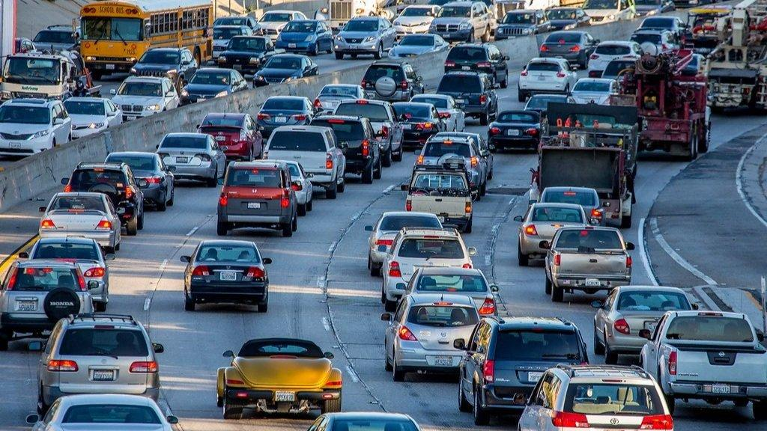
Traffic Safety & Traffic Congestion

Slide 4
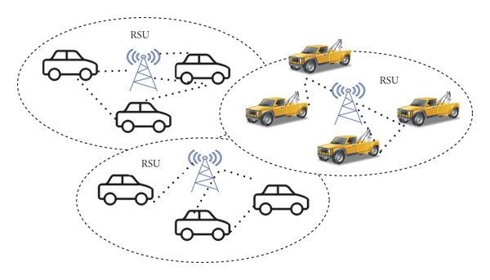
The Deployment of RSUs
A roadside unit (RSU) is an important infrastructure for V2I communication.
The deployment of RSUs will provide a communication gateway for road traffic management authorities as well as infotainment service providers.

Slide 5
Question
What is the difference between LOS and NLOS?

Slide 6
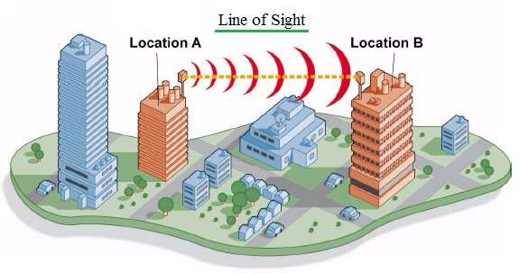
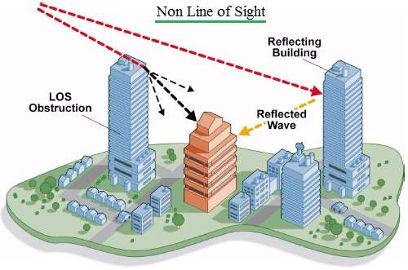
LOS vs NLOS

Slide 7
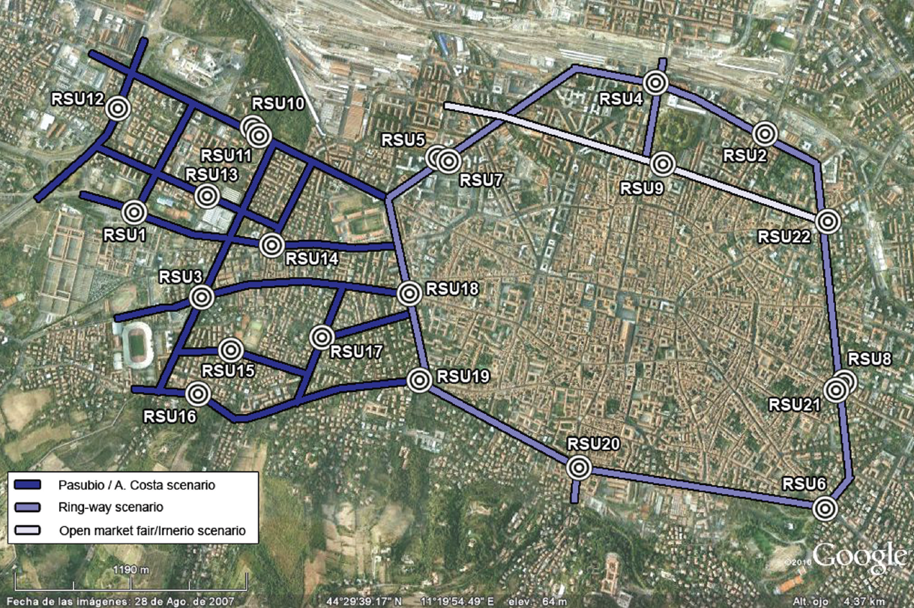
V2I AND V2V COMMUNICATION FIELD TESTS

Slide 8
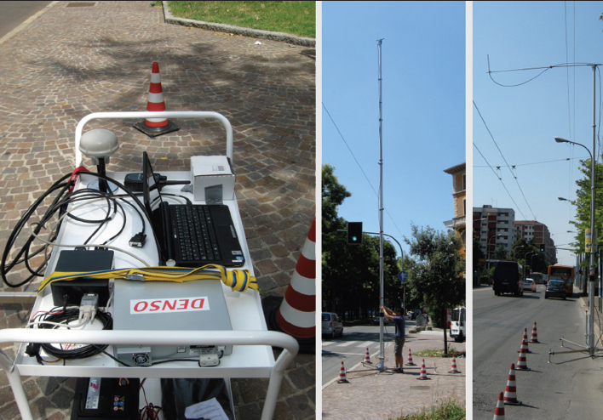
MEASUREMENT CAMPAIGN: SCENARIO AND SETUP
URBAN SCENARIO
RSU equipment and deployment.
The field testing focused on the 3 urban
scenarios:
Pasubio|A. Costa
ring-way
Open Market Fair|Irnerio

Slide 9

EQUIPMENT
The field testing used one OBU in a vehicle and two portable RSUs, all of them equipped with an IEEE 802.11p DENSO Wireless Safety Unit prototype controlled by a standard laptop.
The tests contained the deployment of different type of masts as shown in the center and right photo of the previous slide, that represents the RSU equipment deployed during the tests.
Next: Experimental Results

Slide 10
Experimental Results
•V2I communication performance measured during field tests in city of Bologna in Italy
•Measured through PDR as a function of distance between OBU and RSU
Performance Indicators
RCR if PDR > 0.7 - High Quality V2I transmissions.
UCR if PDR < 0.1 - Low Quality V2I transmissions.
Acronyms:
PDR - Packet Delivery Ratio
OBU - On Board Unit
RSU - Road Side Unit
RCR - Reliable Connectivity Range
UCR - Un-reliable Connectivity Range

Slide 11
Experimental Results - LOS conditions
LOS – Line of Sight conditions
NLOS – Non-Line of Sight conditions
Scenario 1 – Straight Streets without obstacles (LOS)
Antenna Height = 6.5m
Power Levels = 10dBm and 20dBm

Slide 12
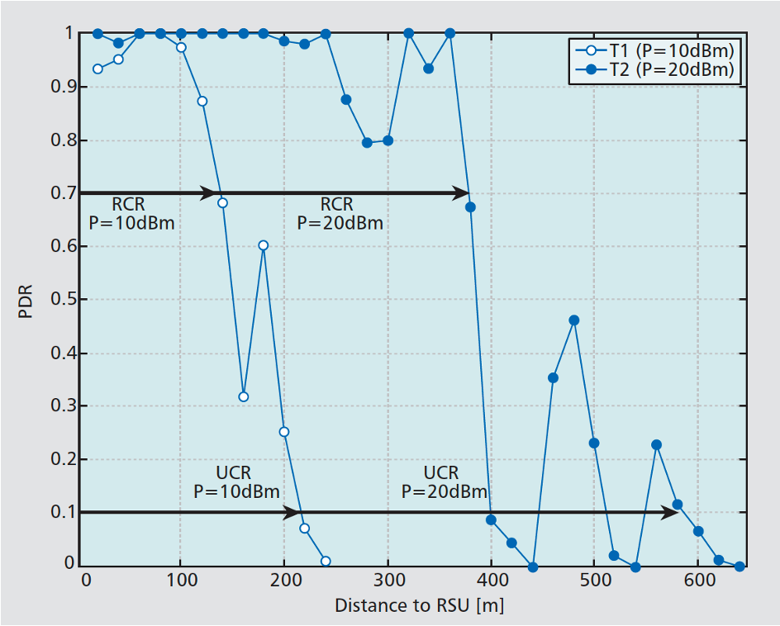
PDR (vs) Distance from OBU to RSU (LOS conditions)

Slide 13
Experimental Results - NLOS conditions
Urban environments have streets with multiple intersections and curves
These environments provoke NLOS conditions between RSU and OBU
Scenario 1 - Bologna’s ringway under low traffic density
Antenna height = 6.5m; power levels = 10dBm and 20dBm
Sharp curve at 340m from RSU
Increasing the transmission power levels did not impact the RCR and UCR due to strong NLOS conditions
Difference between RCR and UCR significantly reduced due to sudden loss of connectivity after curve

Slide 14
Experimental Results - NLOS conditions(contd.)
Scenario 2 – A.Costa Avenue under low traffic density
Antenna height = 6.5m; power levels = 10dBm and 20dBm
Smooth curves and lighter NLOS conditions
No sudden drop in link connectivity due to smooth curves
Difference between RCR and UCR approximately 150m

Slide 15
Experimental Results - NLOS conditions(contd.)
Scenario 3 – Bridges and Terrain Elevation
Antenna height = 6.5m; power level = 20dBm
Connectivity lost after reaching top of bridge (140m from RSU)
Rapid decrease in link performance observed

Slide 16
Experimental Results - NLOS conditions(contd.)
Scenario 4 – Trees and Vegetation
Antenna height = 6.5m and 10.5m; power level = 20dBm
V2I communications improved with lower antenna heights due to trees and foliage blocking path at higher heights
6.5m was better than 10m
But decreasing it further to 3m caused more link variability due to presence of surrounding vehicles

Slide 17
Experimental Results - NLOS conditions(contd.)
Scenario 5 – Traffic
Antenna height = 6.5m; power level = 20dBm
High traffic density conditions significantly decreased the RCR and increased the link variability

Slide 18
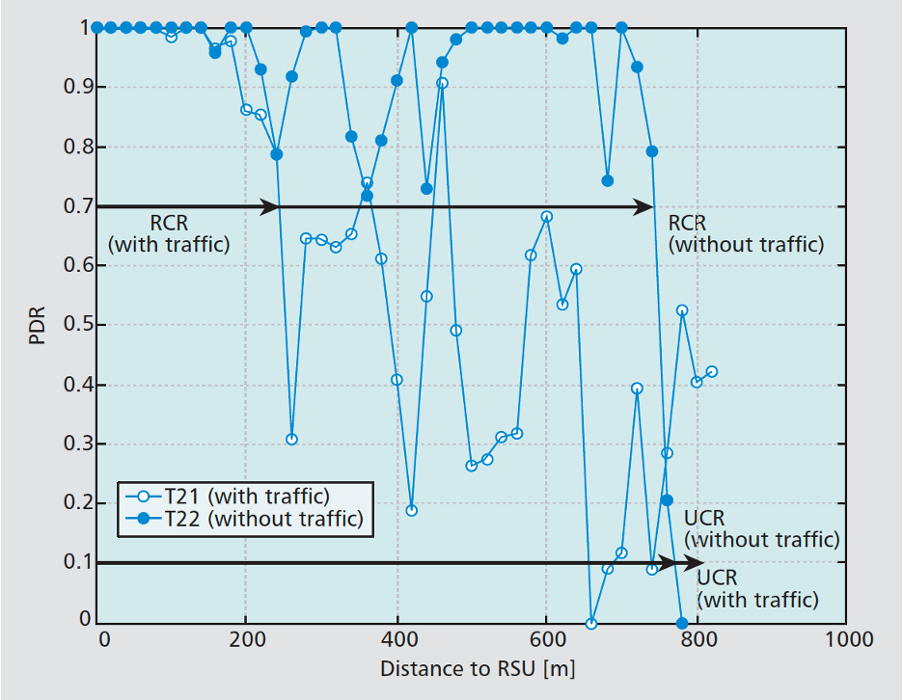
PDR (vs) Distance from OBU to RSU (Traffic vs Non-traffic)

Slide 19
Experimental Results - NLOS conditions(contd.)
Scenario 6 – Heavy Vehicles
Antenna height = 6.5m and 10.5m; power level = 20dBm
Presence of a bus can decrease RCR by more than 200m
Antenna height increased (from 6.5m to 10.5m) to overcome the negative effect of bus
But large trees avoided any possible benefits from antenna height increase

Slide 20

Developing Guidelines for RSU Deployment
The purpose of this research
Develop set of guidelines
Aid in the deployment and utilization of V2I communications infrastructure.

Slide 21

Guidelines for Coop. RSUs in Urban Environments
NLOS conditions
Sharp curves, buildings
Tough to deal with
Drastically reduces communications range.
Can be partially overcome
High transmission power
Careful selection of mast
Large/Heavy vehicles
Ie. busses, trucks, heavy machinery
Sig. reduces communication range when obstructing
Higher antenna masts can help
Depends on other environmental factors
Trees, obstacles, etc.

Slide 22
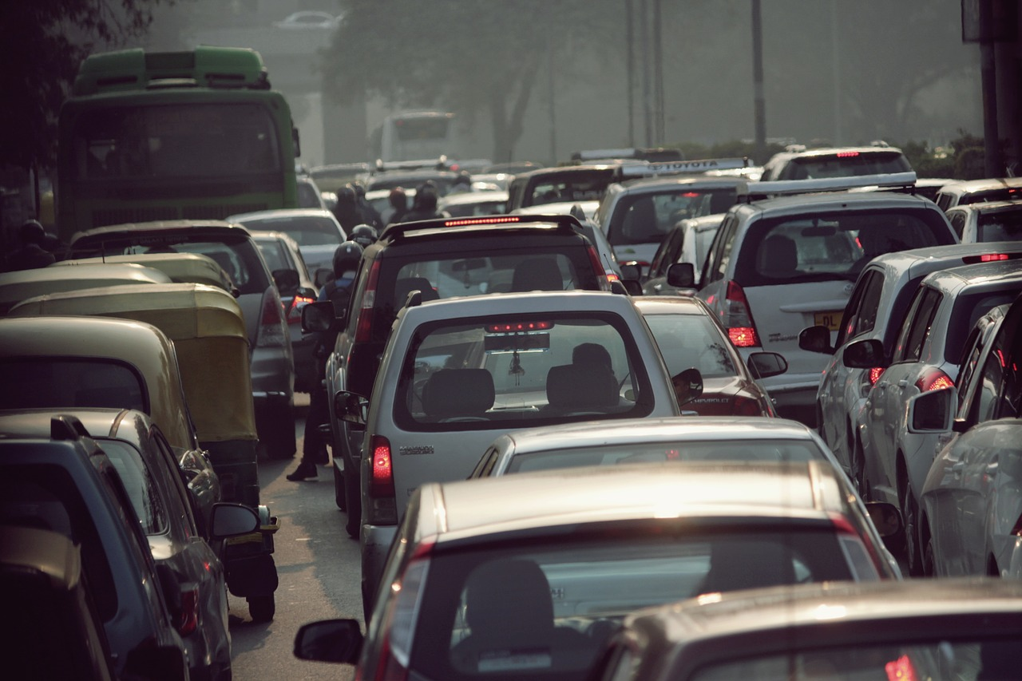
Guidelines for Coop. RSUs in Urban Environments (CONT.)
Sig. variations in elevation
Bridges, slopes, etc
Strongly Impacts connectivity
Difficult problem to solve
Trees/Vegetation
Optimal height for antenna will depend
Height of trees
Vegetation on trees
Specific characteristics of trees
High traffic density
Has been shown to increase link variability
Partially overcome
High antenna masts
Does not sig. Reduce UCR

Slide 23
IN CONCLUSION
To benefit from coop. vehicular services in urban areas, extra care must be taken when deploying infrastructure units.
Some things to take into consideration
Type of services provided by connection
Budget restrictions
Impact of urban environments on V2I communications (BIG ONE)
What this research teaches us
Factors affect V2I communications range and should be properly dealt with by the presented methods
Street layout, elevation, traffic density, heavy vehicles, trees/vegetation

Slide 24
Future Work
Applications of Cooperative Vehicular Services
Intelligent transportation system (ITS)
Real-time advisories for road conditions, traffic, accidents, parking, etc.
Traffic management supervision systems
Adjust traffic signal phase and timing, set variable speed limits
Increase fuel economy and traffic flow
Advancements in driver assist and driverless car technologies.

Slide 25

Ethical Implications
Vehicle to Infrastructure (V2I) Communications have potential benefits
Make our roads safer
Increase fuel economy
Decrease traffic congestion
But there are ethical implications with what’s done with the information gathered by these systems.
Gps tracking
Automated traffic fines
Variable speed limits

Slide 26
References
J. Gozalvez, M. Sepulcre and R. Bauza, "IEEE 802.11p vehicle to infrastructure communications in urban environments," in IEEE Communications Magazine, vol. 50, no. 5, pp. 176-183, May 2012, doi: 10.1109/MCOM.2012.6194400.

Slide 27

THANK YOU!

